Slide 1
The Wrapup
YOU MADE IT

Slide 2
Best Practices
Now that you’re an official coder, you should be aware of Best Practices
ADF&G Best Practice Guide – Contains practical tips!

Slide 3
Matt & Justin’s Top 10 Tips
1) Practice, practice, practice
2) Ask for help!
3) Go slow, be thorough
4) Build for the future
5) Comment HEAVILY
6)
7)
8)
9)
10)
Notes:
Give yourself grace
Build something fun for you

Slide 4
What’s next?!
You now know the basics of R! If you want to be successful, you will need to keep practicing.
Review / complete assignments
Work on your OWN R project!
Email Matt and/or Justin
Next week Next Month 6 Months
Review presentation Practice coding
Re-visit presentations

Slide 5
Parting Thoughts
Like any language, becoming familiar with R requires a little practice over a long period of time. It’s easy to get discouraged initially.
Keep googling your problems: it’s very unlikely that you’re the first with this issue. I still google how to do something almost every other line of code.
Programming is not the same as asking the right questions: learn more statistics! It is possible that you are attempting analysis that is best accomplished differently. Or worse, doing something you shouldn’t.
Notes:
However, unlike spoken languages, you can take your time! It took me 10 minutes to write a line of code before. It’s OK to go slow.
For me, the best way to motivate myself to learn was having my own dataset to work through; for others, online tutorials were best.
Even the best programmers still google and read Stack Exchange.

Slide 6

Congrats!
This certificate is good for a free R help session, one-on-one!
Plus, you’re always welcome to ask one of us for help; the worst we can say is “I’m busy”
Notes:
We really enjoy helping people with their R questions. Please message us

Slide 7
Resources
Just Starting Out – Teach yourself!
https://datacarpentry.org/R-ecology-lesson/00-before-we-start.html
Learnr tutorial about NAs
Learnr tutorial about filtering
Learnr tutorial about summarizing
https://r-bootcamp.netlify.app/
https://rstudio.cloud/learn/primers
https://ggplot-dplyr-intro.netlify.app/
Just Starting Out - Comprehensive
In-depth Resource 1
In-depth Resource 2
Similar layout to class!

Slide 8
Resources
Data Management
Data Organization in Spreadsheets
https://annebeaudreau.com/2018/02/04/data-management-tips/
Workflow
https://whattheyforgot.org/project-oriented-workflow.html
https://www.tidyverse.org/articles/2017/12/workflow-vs-script/

Slide 9
Resources
Style Guides
http://r-pkgs.had.co.nz/style.html
https://google.github.io/styleguide/Rguide.xml
Statistics
http://www.shinystats.org/
https://seeing-theory.brown.edu/regression-analysis/index.html

Slide 10
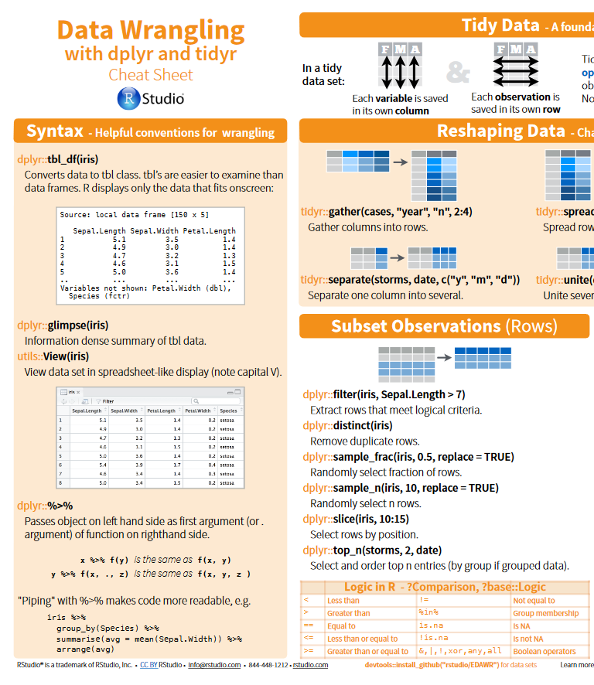
Cheatsheets
All cheatsheets
Getting started
dplyr and tidyr
Data import
lubridate
ggplot2
RStudio

Slide 11
Special Thanks
People who have taught & helped us or whose code we’ve have shamelessly copied and learned from:
Justin:
Franz Mueter (UAF)
Ben Williams (NOAA/ADF&G)
Jordan Watson (NOAA)
Curry Cunningham (UAF)
Jenny Bryan (UBC)
Hadley Wickham (RStudio)
Allison Horst (RStudio)
Rhea Ehresmann (ADF&G)
Adam Reimer (ADF&G)
Matt:
Alan Turing (AI)
Hari Seldon (Trantor)
HAL (Clarke)
Tim Berners-Lee (CERN)
Inigo Montoya (Spaniard)
Marvin Minsky (MIT)

